Slide 1



Atliq Grand BI

Slide 2

About Us
AtliQ Grands owns multiple five-star hotels across India
Operating in the hospitality industry for over 20 years
Presence across four major cities: Bengaluru, Delhi, Mumbai, Hyderabad
Operates in Luxury and Business hotel categories

Slide 3

Problem Statement
Declining revenue in luxury and business hotel segments
Loss of market share due to aggressive competitor strategies
Inconsistent occupancy across cities and properties
Ineffective pricing and revenue management decisions
Lack of in-house data analytics capability
Limited visibility into performance-driving factors

Slide 4
Data & Tool Used
Source Of Data
Tool Used
Business
Assumptions
Analysis Period
Excel Files
Microsoft Excel
May 2022
TO
July 2022
Weekend: Fri–Sat
Power Query
Power Bi
Weekday: Sun–Thu

Slide 5
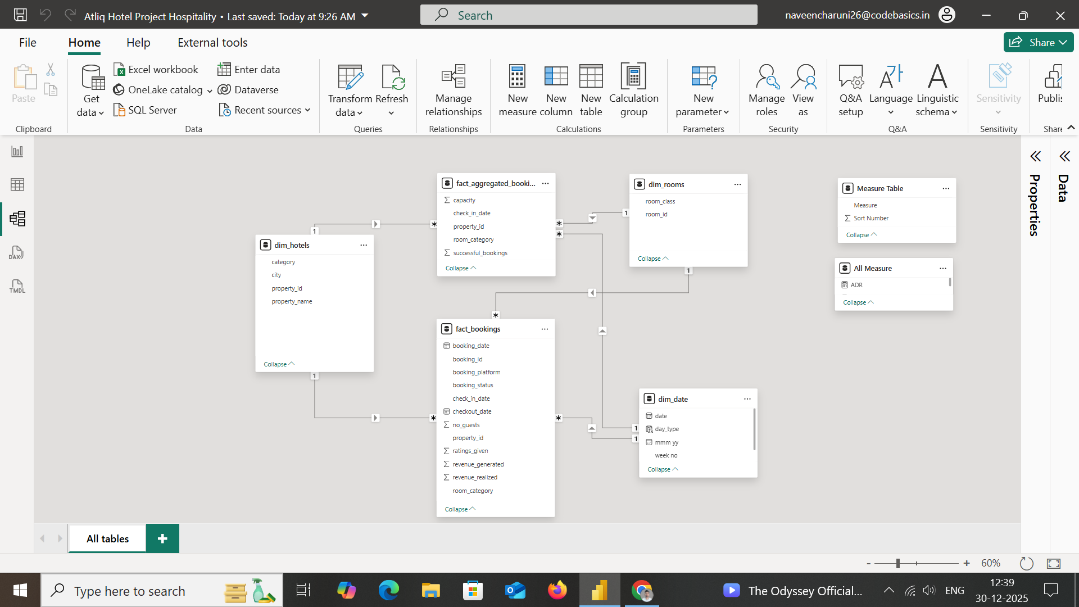
Data Modeling

Slide 6


